Slide 1


Design and Development of Quadrature Branchline coupler using Slow Wave structure
GUIDED BY
Dr. P. Rajeswari
Associate Professor /ECE
PRESENTED BY
Afrin Jumana M (913119106005)
Jeeva Getzie Cynthia A (913119106038)
Srinthi A (913119106109)
FINAL YEAR ECE
9131 - Velammal College of Engineering & Technology
(Autonomous)

Slide 2
OUTLINE
Abstract
Introduction
Literature Survey
Problem Statement
Objectives
Conventional Coupler
Existing Design
Proposed Method
Advantages
Result & Discussion
Fabricated Coupler
Measured Result
Relevance to Society
Conclusion
Reference

Slide 3
INTRODUCTION
Hybrid Couplers are essential devices in various microwave circuits and systems such as radar systems and beam forming networks.
The principle of a hybrid coupler is that the input power is split equally between the coupled and through ports, with a 90 degree phase difference.
The fourth (isolated) port is terminated by a 50- ohm load.
In RF transceiver systems, hybrid couplers are invariably used to divide or combine signal using a proper phase difference.
The 90° and 180° hybrid couplers are widely used to combine RF(radio frequency), LO( local oscillator), IF(Intermediate frequency) frequencies. Furthermore to provide sufficient power, hybrid couplers are incorporated with several nonlinear amplifier.
In this study the hybrid coupler is designed for 1.3GHz with impedance (z₀) is 50Ω, dielectric constant εr is 4.4.

Slide 4
INTRODUCTION
Simulation is done by HFSS software.
In order to keep up with the huge changes in future technologies, couplers still requires noticeable improvement, where wide bandwidth and low loss should be achieved throughout using modern guiding technology such as Ridge Gap Waveguide (RGW) in future work.
The proposed coupler has a compact size of 27.2 mm × 27.2 mm at the frequency of 1.3 GHz.
In addition, a stable 90° phase difference between the coupling and transmission coefficients is obtained over the whole frequency band.
This allows for a wide range of applications such as medical devices, and other IoT networks.
The proposed directional coupler is fabricated and measured, where the measured results show good agreement

Slide 5
LITERATURE SURVEY
S.no | Title of the paper | Author & Date | Methodology | Findings
1 | Miniaturization of microstrip directional coupler by means of artificial transmission lines | Letavin Denis A, Hung Luu Quang 1 January 2018 | Minaturization Technique | Artificial transmission lines are used with introduction of open-circuit stubs into the free space inside the bridge coupler which allows to achieve a significant surface area reduction of the substrate.
2 | A Compact, Ultra-Wideband, Transformer-Based Quadrature Signal Generation Network in 45 nm CMOS SOI for 5G Application. | Yuzhe Zhu, Xuchi Liu, Xiaoran Li, Zicheng Liu, Quanwen Qi 11 August 2022 | CMOS SOI Technology | Ultra Wideband Signal Generation Network provides low loss and ultra-wide bandwidth

Slide 6
LITERATURE SURVEY
S.no | Title of the paper | Author & Date | Methodology | Findings
3 | Butler Matrix Based Beamforming Networks For Phased Array Antenna Systems | Arshad Karimbu Vallappil, MKA Rahim, Bilal A Khawaja 28 December 2020 | Butler Matrix Technique | Matamaterial based bi-layer BM provides low insertion loss and phase error, good S parameter performance
4 | Millimeter-Wave Substrate Integrated Waveguide Using Micromachined Tungsten-Coated Through Glass Silicon via Structures | Ik-Jae Hyeon, Chang-Wook Baek 9 April 2018 | SIW based Micromaching based fabrication Technology | The return loss is better than 10 dB in a frequency range from 20 GHz to 45 GHz

Slide 7
LITERATURE SURVEY
S.no | Title of the paper | Author & Date | Methodology | Findings
5 | A Low-Cost Wideband 77-GHz Planar Butler Matrix in SIW Technology | Tarek Djerafi, Ke Wu 05 July 2012 | Substrate integrated waveguide (SIW) technology | The use of 77 GHz switched-beam slot antenna array driven by a Butler Matrix achieves reduced network losses
6 | SIW Butler Matrix with Modified Hybrid Coupler for Slot Antenna Array | Qing-Ling Yang, Yong-Ling Ban, JI-Wei Lian, Zhe-Feng Yu, Bian Wu 29 December 2016 | SIW Technology and Butler Matrix technique | 90 degree SIW Hybrid Coupler designed with equal length unequal width phase shifter shows excellent performance with wideband and flat phase balance

Slide 8
LITERATURE SURVEY
S.no | Title of the paper | Author & Date | Methodology | Findings
7 | Development of Compact and Flexible Quadrature Hybrid Coupler Using Coaxial Cable with Capacitive Loading for 1.5 T Indigenous MRI System | Rohit Apurva, Niraj Yadav, Tapse Bhuiya, Rajesh Harsh 12 October 2020 | Capacitive Loading Technique | Coaxial Cable transmission line with lumped capacitive loading can handle high power and reduces the size of hybrid coupler by 68%
8 | Compact Reflectionless Band Pass Filter: Based on GaAs IPD Process for Highly Reliable Communication | Xiaozhen Li, Mengjjiang Xing, 1 December 2021 | GaAs Integrated Passive Device Technology | Use of Reflectionless Band Pass Filter with GaAs IPD Process provides better insertion loss, return loss

Slide 9
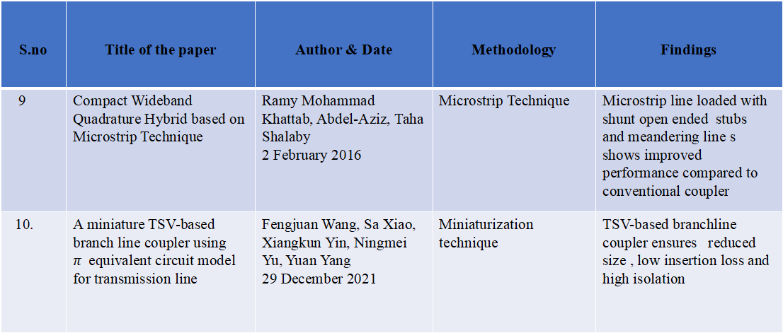
LITERATURE SURVEY
S.no | Title of the paper | Author & Date | Methodology | Findings
9 | Compact Wideband Quadrature Hybrid based on Microstrip Technique | Ramy Mohammad Khattab, Abdel-Aziz, Taha Shalaby 2 February 2016 | Microstrip Technique | Microstrip line loaded with shunt open ended stubs and meandering line s shows improved performance compared to conventional coupler
10. | A miniature TSV-based branch line coupler using $π$equivalent circuit model for transmission line | Fengjuan Wang, Sa Xiao, Xiangkun Yin, Ningmei Yu, Yuan Yang 29 December 2021 | Miniaturization technique | TSV-based branchline coupler ensures reduced size , low insertion loss and high isolation

Slide 10
PROBLEM STATEMENT
The compact size and high performance are demanded in many microwave communication systems. The important component widely applied in microwave circuit design is the quadrature branchline coupler.
It is typically used in high frequency transmission and low frequency transmission line.
Branch-line couplers can be made compact by utilising metal-insulator-metal (MIM) capacitors, however these capacitors are lossy and challenging to match in the mm-wave range. Others have focused on implementing low-loss couplers with wideband and balanced output performance, but the size is not well constrained .
One of the key challenges in microstrip line design is achieving a high quality signal with minimal loss and distortion.
This can be achieved by carefully selecting the substrate material and optimizing the dimensions of the microstrip line.
The problem is to design a quadrature branchline coupler with low insertion loss and small phase difference error in a wide frequency range.

Slide 11
OBJECTIVES
To design a quadrature branchline coupler using slow wave structure.
To compare the design of conventional coupler with proposed coupler design.
To measure the performance of proposed coupler with existing coupler design.

Slide 12
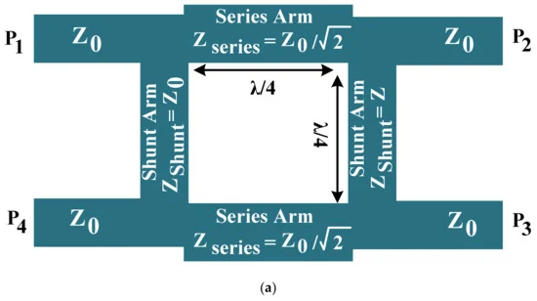
CONVENTIONAL COUPLER DESIGN
The Conventional Branch Line Coupler is the simplest type of quadrature couplers, since it is entirely planar. They couple a defined amount of electromagnetic power in a transmission line to a port enabling the signal to be used in another circuit.
The Basic Branch line coupler comprises four ports: The first port is the input port (Incident), Port 2 is the output port (Transmitted), Port 3 is the coupled port (Forward Coupled Port), Port 4 is the isolated port (Reverse Coupled Port)
The power enters through the any one of the input ports is divided equally between the two output ports with quadrature phase difference and the remaining port is isolated.
The bandwidth of branch line coupler is limited to 10 - 20 % which can be applied only for narrow band circuits . It is composed of four quarter wave length transmission lines.

Slide 13
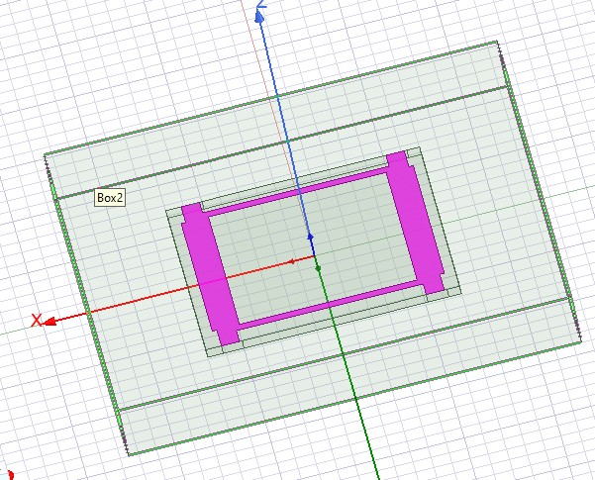
CONVENTIONAL COUPLER DESIGN
HFSS Structure of conventional coupler

Slide 14
EXISTING DESIGN
It is a brief analysis of the existing methods of reducing microstrip device dimensions.
Based on this method, a compact directional coupler, which divides the power in a 1:2 ratio, was designed and manufactured.
It uses quarter-wave transmission line segments.
The compact directional microstrip coupler, operating at the frequency of 1900 MHz. FR4 was used as substrate material in the designed structure, with dielectric permeability İ = 4.4 and thickness of h = 1 mm.
The proposed miniaturization method allowed reducing the bridge coupler dimensions by 70% compared to the standard design.

Slide 15
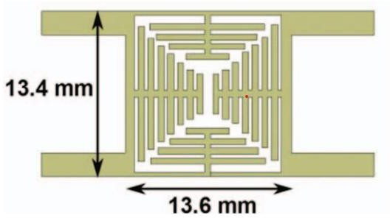
EXISTING DESIGN
Design of the coupler

Slide 16
EXISTING DESIGN
In order to increase the miniaturization efficiency, the length of each stub is selected individually. This allows positioning all the elements in the most compact manner.
The dimensions of the miniature structure are 13.4 mm x 13.6 mm = 182.2 mm².
Using the R&S vector network analyzer, the experimental characteristics were obtained, which coincided with simulation results with minor error.
The working frequency band, determined by decoupling level of -20 dB, is reduced by approximately 38%. Also, the propagation ratio loss was increased

Slide 17
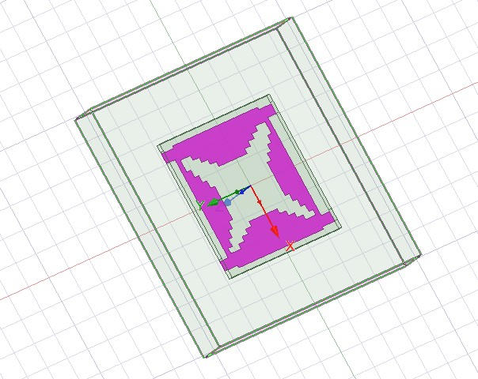
EXISTING DESIGN
Simulated Structure of the coupler

Slide 18
PROPOSED METHOD
The Quadrature Branchline Coupler using slow wave structure is proposed.
A microstrip line is a type of transmission line which contains of a thin conducting strip (usually made of copper) that is placed on top of a dielectric substrate, with a ground plane on the other side. The strip and the ground are separated by the dielectric substrate.
The strip width, substrate thickness and dielectric constant are the main design parameters that affect the impedance and performance of a microstrip line.
Here Artificial Transmission lines are installed instead of quarter-wave segments.
The proposed Artificial Transmission Lines have the same phase progression of 90 degrees at the operating frequency as the quarter-wave segment.
A quarter-wave line, also known as a quarter -wave transformer or quarter-wave matching section, is a type of transmission line used in radio frequency (RF) and microwave systems.

Slide 19
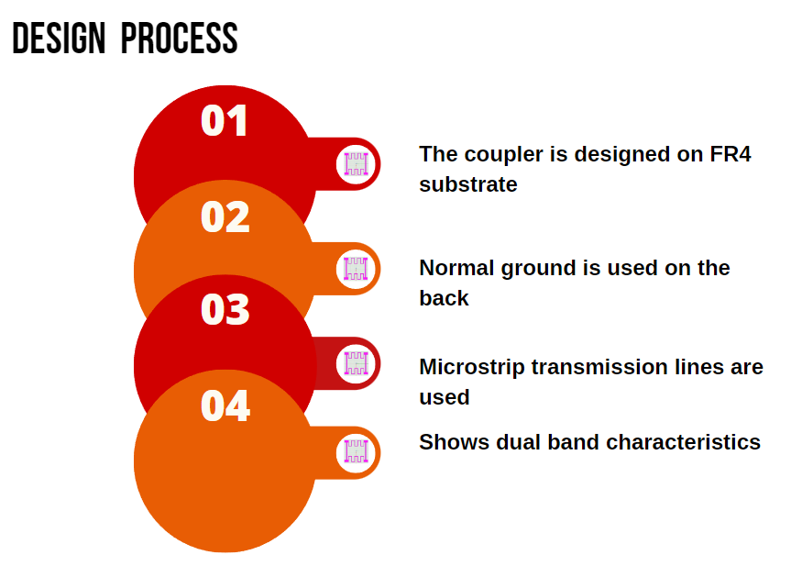
PROPOSED METHOD

Slide 20
PROPOSED METHOD
It is used to match the impedance of two different transmission lines or components in a circuit that have different characteristics impedances.
The substrate used for simulation is FR4 with relative permittivity 4.4 and relative permeability 1. FR" stands for "flame retardant". It is made up of multiple layers of fiberglass cloth and epoxy resin and is designed to resist heat and fire.
The total dimension of the coupler is 27.2mm x 27.2mm. The length of the series arm L1 is 27.2 mm. The length of shunt arm is 27.2mm.
In this design, perfect serpentine line section is substituted. A study of simulation fabrication, and system integration for the development of coupler of two- dimensional serpentine pattern is briefed.
The proposed design is compared with conventional branchline coupler and existing design and S-parameters are analyzed using HFSS design tool.

Slide 21
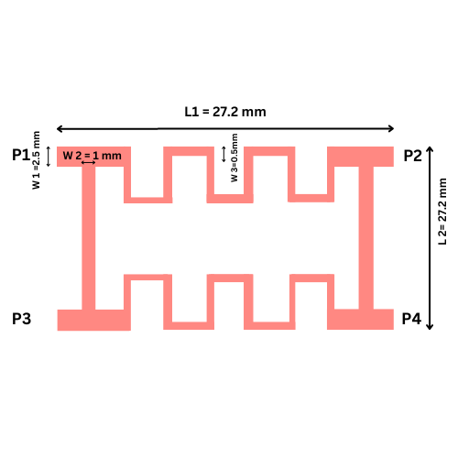
PROPOSED METHOD
Dimension of proposed coupler
SYMBOL | L1 | L2 | W1 | W2 | W3
VALUE (mm) | 27.2 | 27.2 | 2.5 | 1 | 0.5
Front view of Proposed design

Slide 22
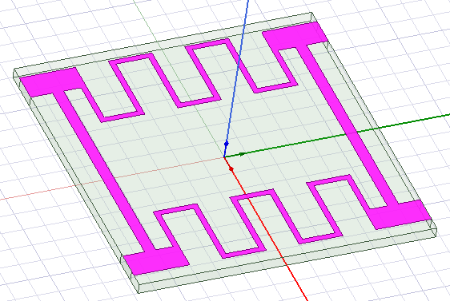
PROPOSED METHOD
DESIGN SPECIFICATION
Frequency | 1.3GHz
Substrate | FR4
Substrate thickness | 1.25 mm
Dielectric constant | 4.4
HFSS Structure of Proposed design

Slide 23
ADVANTAGES
Simple fabrication process
Design accuracy
Low loss performance
Less Complexity
Achieves low insertion loss with excellent output balance and a small phase difference error over a wide frequency range

Slide 24
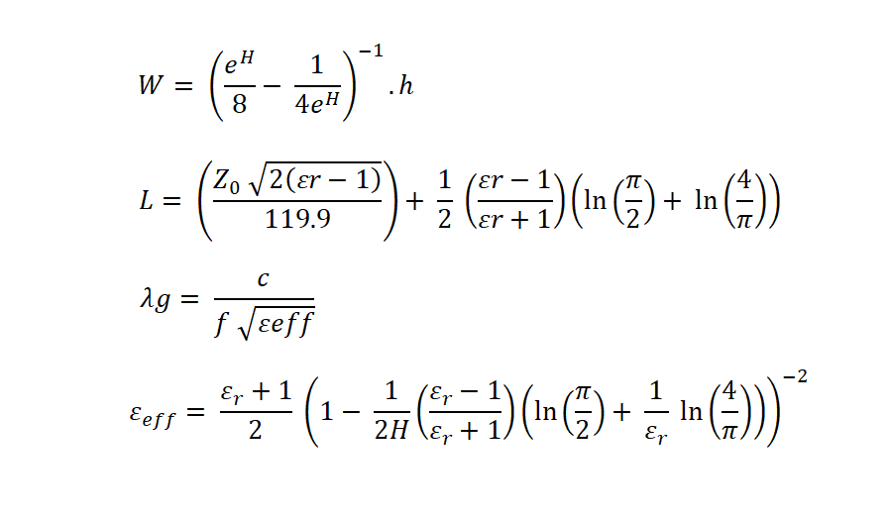
DESIGN EQUATION
(1)
(4)
(2)
(3)
(4)

Slide 25
DESIGN EQUATION
Where
Equation (1) gives the value of transmission line Width .
Equation (2) gives the value of transmission line Length.
c is velocity of light.
f is center frequency.
λ is guided wavelength.
Width and Length of the each design is calculated using the above mentioned equations.

Slide 26
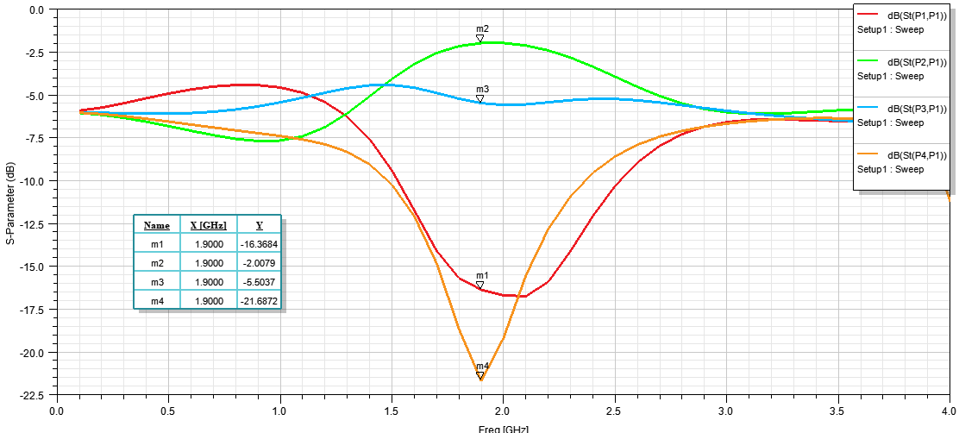
RESULT & DISCUSSION
Simulated result of the Conventional coupler

Slide 27
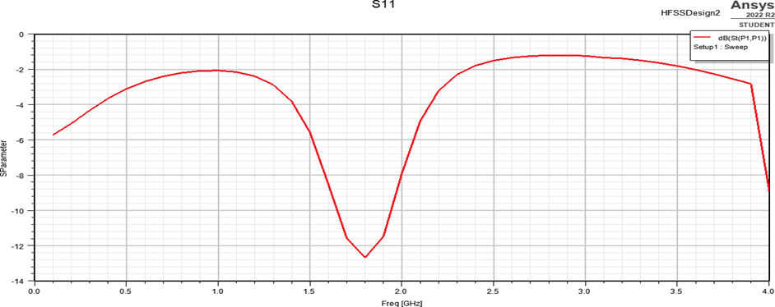
RESULT & DISCUSSION
Simulated S₁₁ Parameter of the Existing coupler

Slide 28
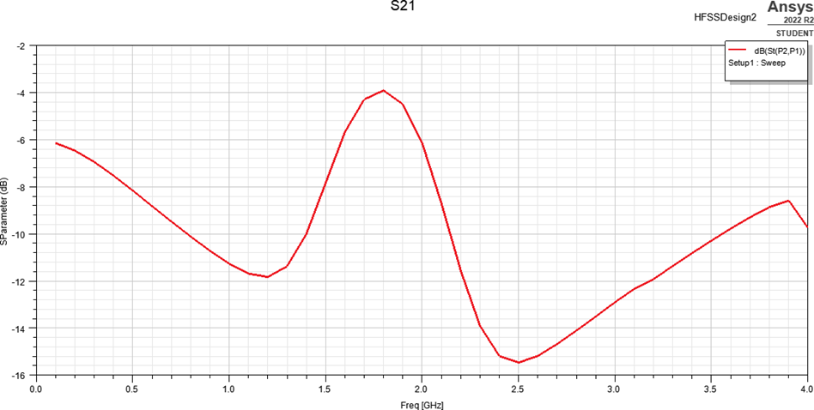
RESULT & DISCUSSION
Simulated S₂₁ Parameter of the Existing coupler

Slide 29
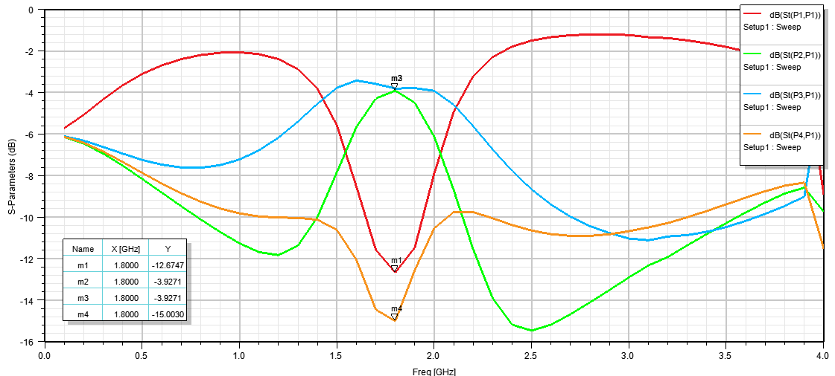
RESULT & DISCUSSION
Simulated Result of the Existing coupler

Slide 30
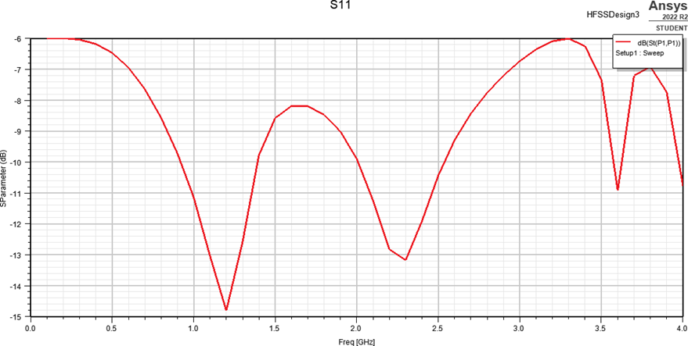
RESULT & DISCUSSION
Simulated S₁₁ Parameter of the Proposed coupler

Slide 31
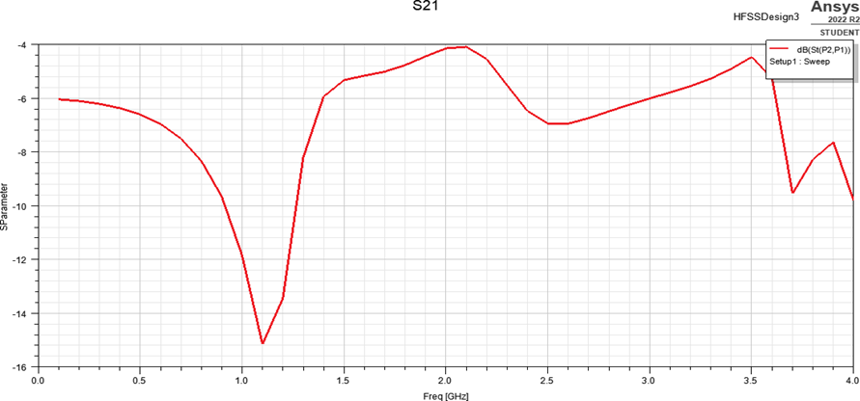
RESULT & DISCUSSION
Simulated S₂₁ Parameter of the Proposed coupler

Slide 32
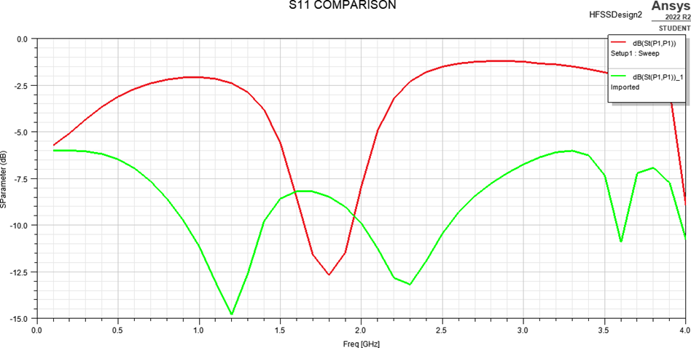
RESULT & DISCUSSION
Simulated Comparison result of S₁₁ Parameter

Slide 33
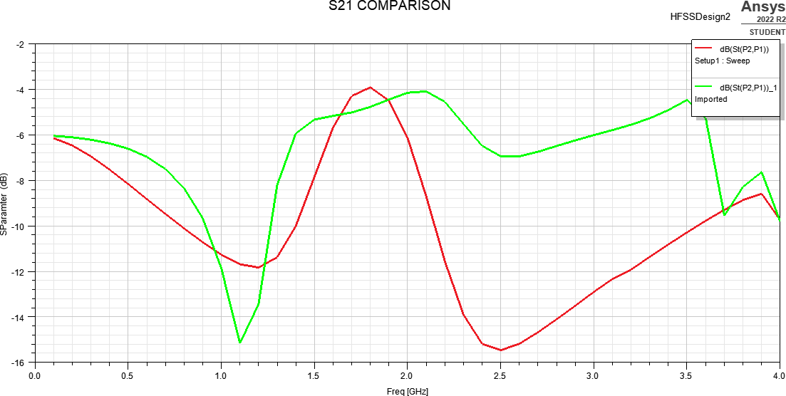
RESULT & DISCUSSION
Simulated Comparison result of S₂₁Parameter

Slide 34
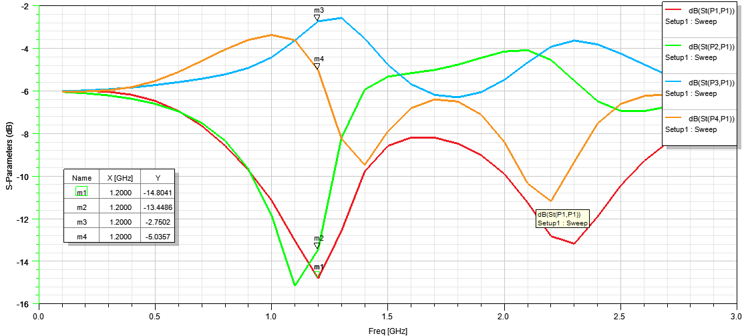
RESULT & DISCUSSION
Simulated Result of the Proposed coupler

Slide 35
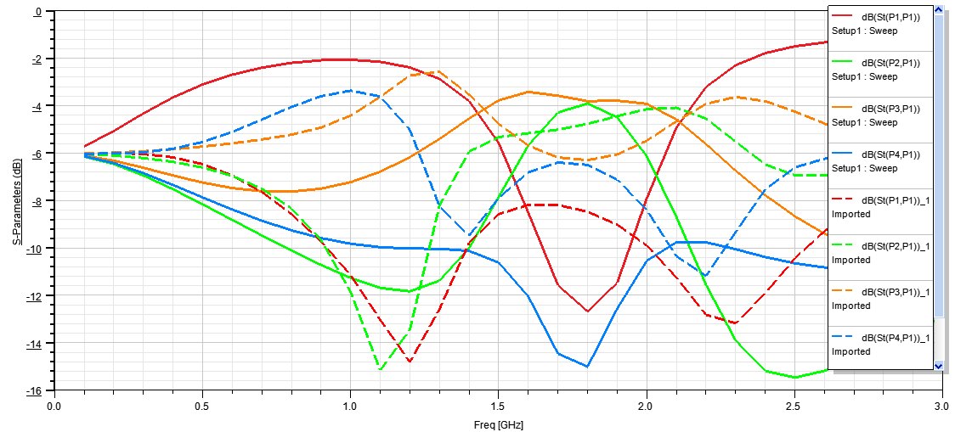
RESULT & DISCUSSION
Comparison of Existing and Proposed coupler S parameters

Slide 36
RESULT & DISCUSSION
Coupler | Operating frequency (GHz) | S₁₁ (Return Loss ) ( db ) | S₂₁ (Insertion loss) ( db )
Existing design | 1.8 | - 12.6747 | - 3.9271
Proposed Method | 1.3 | - 14.8041 | - 13.4486
Summary of S parameters

Slide 37
RESULT & DISCUSSION
S – Parameter | Frequency (GHz) |  | Bandwidth(%)
S11 | f_{H} | 1.4 | 27.27
 | f_{L} | 0.8
S21 | f_{H} | 1.3 | 30
 | f_{L} | 0.7
Bandwidth Utilization of simulated Result

Slide 38
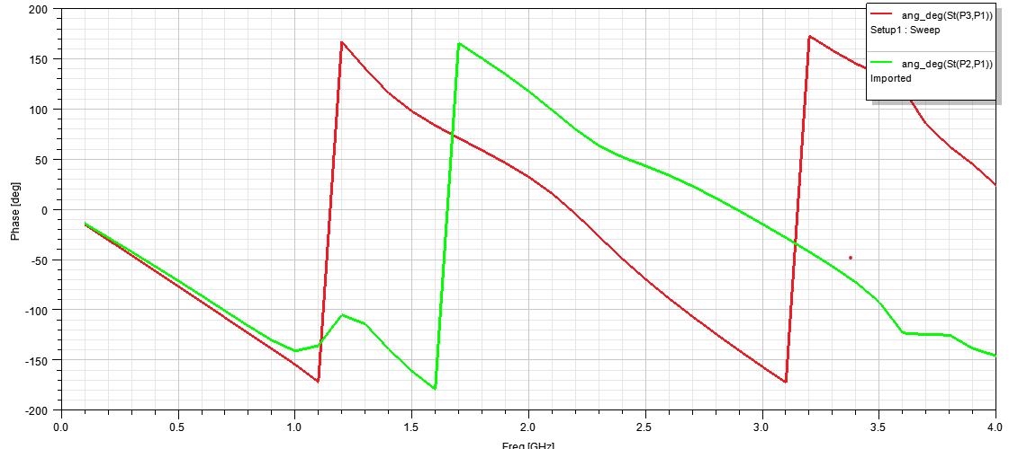
RESULT & DISCUSSION
Phase Difference = 268.32°

Slide 39
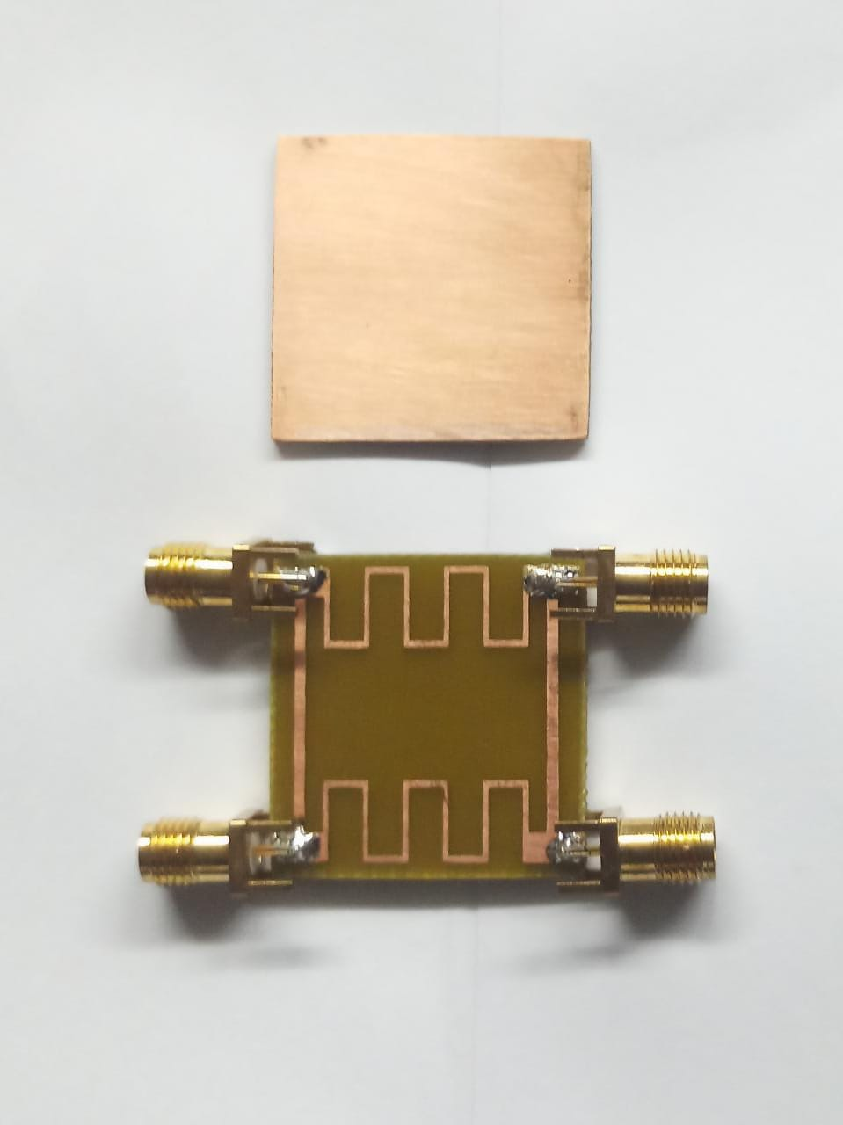
FABRICATED COUPLER

Slide 40
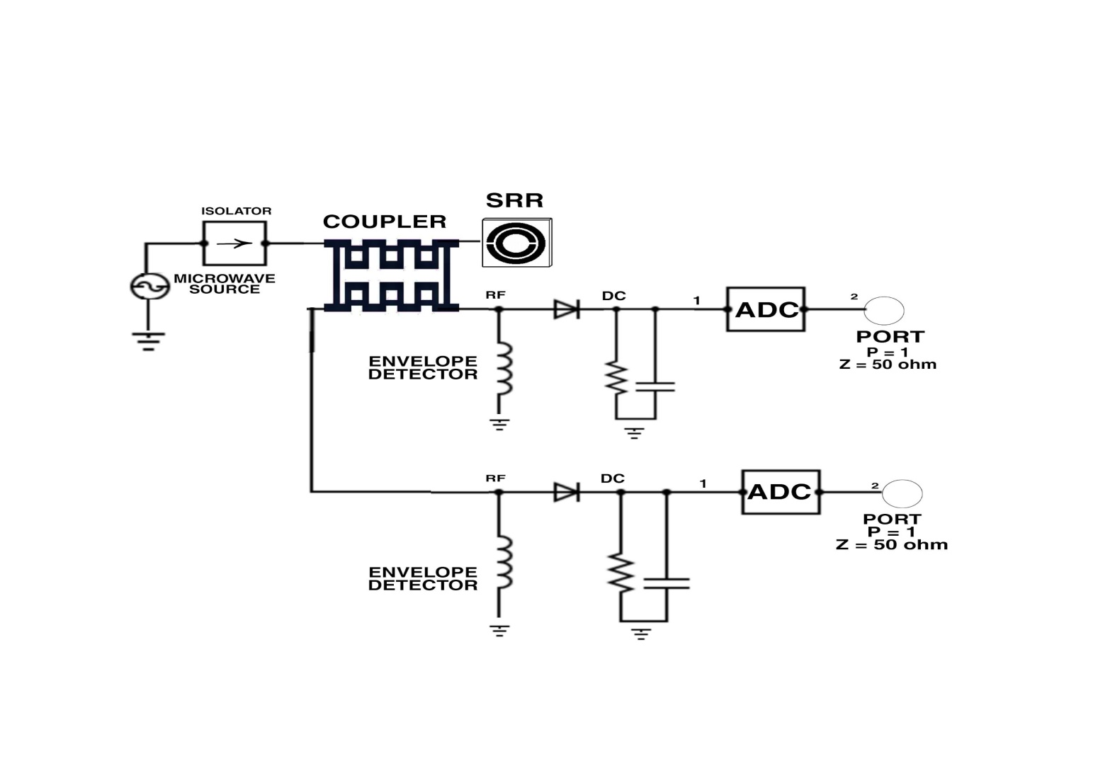
RELEVANCE TO SOCIETY
Power dividers, monitoring power flow in microwave measurements, power combiners.
Musculoskeletal diseases are a substantial health care burden and one of the most expensive diseases leading to long -term sick leave. The existing radiology based diagnosis and monitoring methods usually give no information on the quality of the healing process and cannot be regularly used due to radiation risks.
This can be used for Bone Density Measurement Analysis (BDAS), to develop an embedded system for diagnosis and monitoring of healing of fractures in home care environment.
This solution is cost effective, portable, and easy to use and involves no health hazard. It makes orthopaedic healthcare accessible to everyone and as frequent as needed. Radio Frequency (RF) system design using a directional coupler, envelope detector, Analog to digital converter, isolator and signal source is shown here

Slide 41
CONCLUSION
The Branchline coupler using slow wave structure is proposed.
The suggested solution uses artificial transmission line and a symmetrical layout of a perfect serpentine.
With a relatively small 27.2 mm x 27.2 mm size, it achieves a relative bandwidth of at 1.3 GHz.
Additionally, over the entire frequency band, a stable 90° phase difference between the coupling and transmission coefficients is obtained.
The given solution demonstrates a great potential for applications in medical devices, and the coupler's footprint is substantially less than that of a conventional branch- line coupler.

Slide 42
CONFERENCE DETAILS
2nd InternationalConference on Next Generation
Computing System (ICNGCS - 2023)
PSG Institute of Technology and Applied Research
Presented On : 18-03-2023

Slide 43
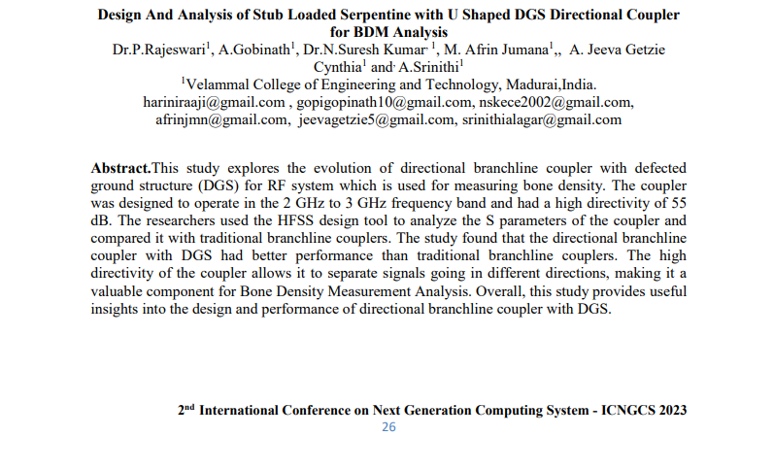
CONFERENCE DETAILS
ICNGCS-2023-Proceeding

Slide 44
REFERENCES
1. Letavin Denis A, Hung L Quang “Miniaturization of microstrip directionall couplwe by means of artificail transmission lines”.
.J.G. Chi and Y.J. Kim: “A compact wideband millimeter-wave quadrature hybrid coupler using artificial transmission lines on a glass substrate,” IEEE Microw. Wireless Compon. Lett. 30 (2020) 1037 (DOI: 10.1109/LMWC.2020.3027921).
2. Amitava Ghosh, Theodore S. Rappaport, Prakash Moorut, George R. MacCartney, “Millimeter-Wave Enhanced Local Area Systems: A High-Data-Rate Approach for Future Wireless Networks”, IEEE JOURNAL ON SELECTED AREAS IN COMMUNICATIONS, VOL. 32, NO. 6, JUNE 2014
3. B Sekharbabu, K Narsimha Reddy, S Sreenu, “Design and Development of a 3dB Quadrature Patch Hybrid Coupler”, DOI:10.14419/ijet.v7i2.6.10570
4. Xiaozhen Li, Mengjjiang Xing:” Compact Reflectionless Band Pass Filter: Based on GaAs IPD Process for Highly Reliable Communication”. Electronics 2021, 10(23), 2998; https://doi.org/10.3390/electronics10232998,1 December 2021
5. Elalaouy, Ouafae, Mohammed El Ghzaoui, and Jaouad Foshi. "A New Four-Ports MIMO Antenna for 5G IoT Applications." In Artificial Intelligence and Smart Environment: ICAISE’2022, pp. 78-85. Cham: Springer International Publishing, 2023.
6. Elshaekh, Dalia N., et al. "Printed circularly polarized spilt ring resonator monopole antenna for energy harvesting." Ain Shams Engineering Journal 14.6 (2023): 102182.
7. T. Djerafi and K. Wu, “A low-cost wideband 77-GHz planar butler matrix in SIW technology,” IEEE Trans. Antennas Propag., vol. 60, no. 10, pp. 4949–4954, Oct. 2012.

Slide 45

REFERENCES
8. Sonnenberg, Timothy, Shane Verploegh, Mauricio Pinto, and Zoya Popović. " W - Band GaN HEMT Frequency Multipliers." IEEE Transactions on Microwave Theory and Techniques (2023).
9. Rohit Apurva, Niraj Yadav, Tapse Bhuiya, Rajesh Harsh:” Development of Compact and Flexible Quadrature Hybrid Coupler Using Coaxial Cable with Capacitive Loading for 1.5 T Indigenous MRI System”. Vol. 93, 143–151, 2020
10. Ramy Mohammad Khattab, Abdel-Aziz, Taha Shalaby:” Compact Wideband Quadrature Hybrid based on Microstrip Technique” ISSN: 2278-0181 IJERTV5IS020472 Published by: Vol. 5 Issue 02, February-2016
11. Qing-Ling Yang, Yong-Ling Ban, JI-Wei Lian, Zhe-Feng Yu, Bian Wu:” SIW Butler Matrix with Modified Hybrid Coupler for Slot Antenna Array”. DOI: 10.1109/ACCESS.2016.264593829 December 2016
12. Yuzhe Zhu 1, Xuzhi Liu ,Xiaoran Li ,Zicheng Liu andQuanwen Qi:” A Compact, Ultra-Wideband, Transformer-Based Quadrature Signal Generation Network in 45 nm CMOS SOI for 5G Applications”. Electronics 2022, 11(16), 2508; Electronics 2022, 11(16), 2508; https://doi.org/10.3390/electronics11162508.
13. I.-J. Hyeon and C.-W. Baek, “Millimeter-wave substrate integrated waveguide using micromachined tungsten-coated through glass silicon via structures,” Micromachines, vol. 9, no. 4, p. 172, Apr. 2018.

Slide 46
Thank You
Queries??

